Slide 1
Netflix Shows Data Analysis

Slide 2

Problem statement
Understand viewer engagement patterns and preferences across demographics . Identify popular content genres and themes. Enhance recommendation algorithms for personalized content suggestions. Evaluate the performance of original vs. licensed content. Anticipate market trends for informed content strategies.
This Photo by Unknown Author is licensed under CC BY-NC-ND

Slide 3
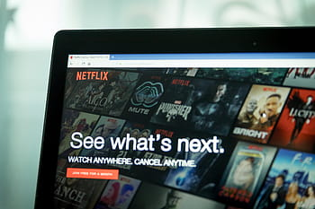
abstract
This study presents a detailed analysis of Netflix shows data using Python programming language. Leveraging popular libraries such as Pandas, NumPy, Matplotlib, and Seaborn,
we explore various aspects of viewer engagement, Our findings contribute to a deeper understanding of audience preferences and provide actionable recommendations for content creators and platform managers. content preferences, and market trends.

Slide 4
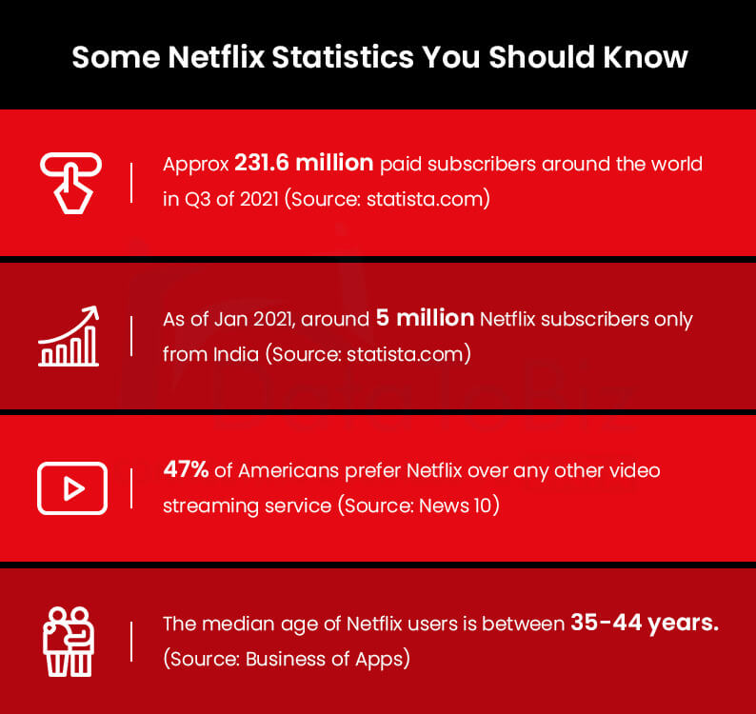
Introduction to Netflix Shows Data Analysis
Netflix offers a wide range of shows across various genres.
Analyzing data related to Netflix shows can provide valuable insights.
This presentation will explore key trends and patterns in Netflix shows data.
Notes:
Image source: https://www.datatobiz.com/blog/netflix-big-data-analytics/

Slide 5
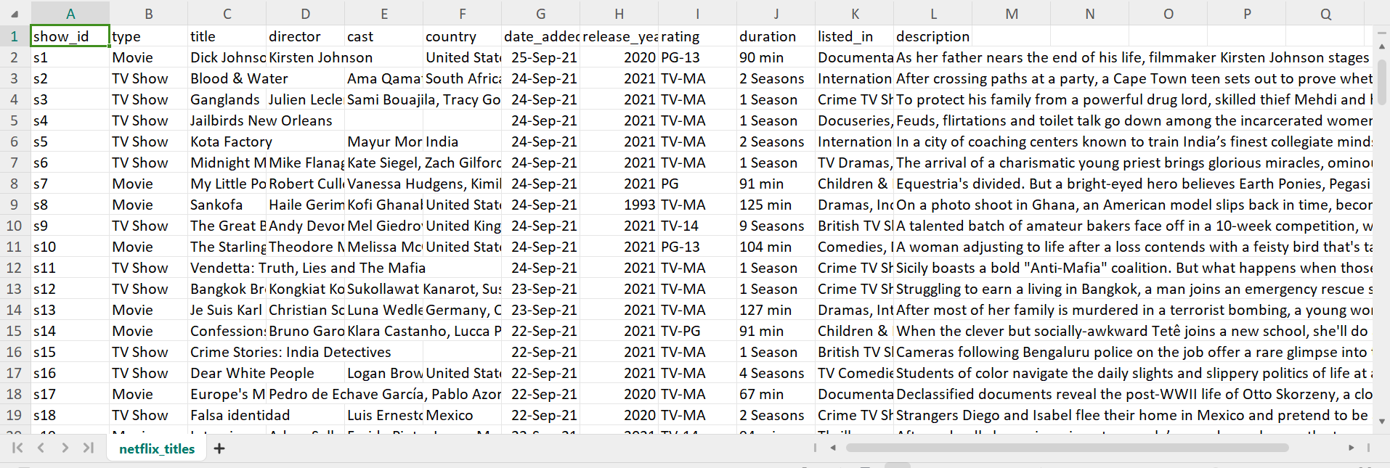
DATASET
We extracted required dataset of project from Kaggle.com.This dataset contains information about movies and TV shows available on Netflix , including details like title, director, cast, release year, and genre. Netflix Movies and TV Shows Dataset

Slide 6
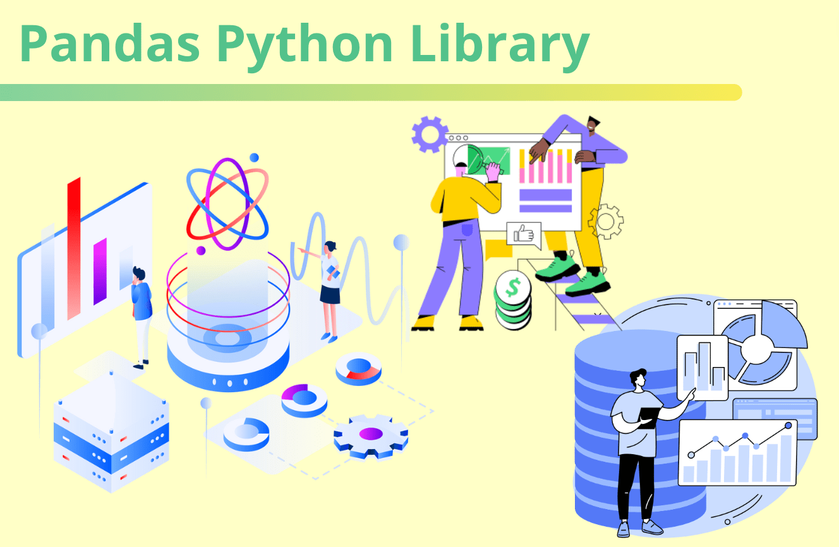
Library Overview
Pandas is a popular Python library used for data manipulation and analysis.
With Pandas, the Netflix dataset can be loaded, cleaned, and structured for analysis.
Functions like group by, merge, and filter can be applied to gain meaningful insights from the data.

Slide 7
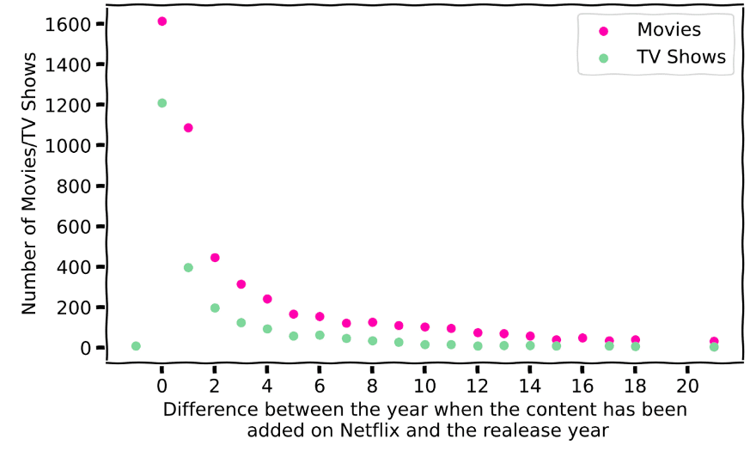
Matplotlib Library for Visualization
Matplotlib is a powerful library for creating visualizations such as line plots, bar charts, and scatter plots.
By using Matplotlib, trends in viewer ratings, genre popularity, and release dates can be effectively visualized.
Visual representations help in presenting findings and making data-driven decisions.

Slide 8
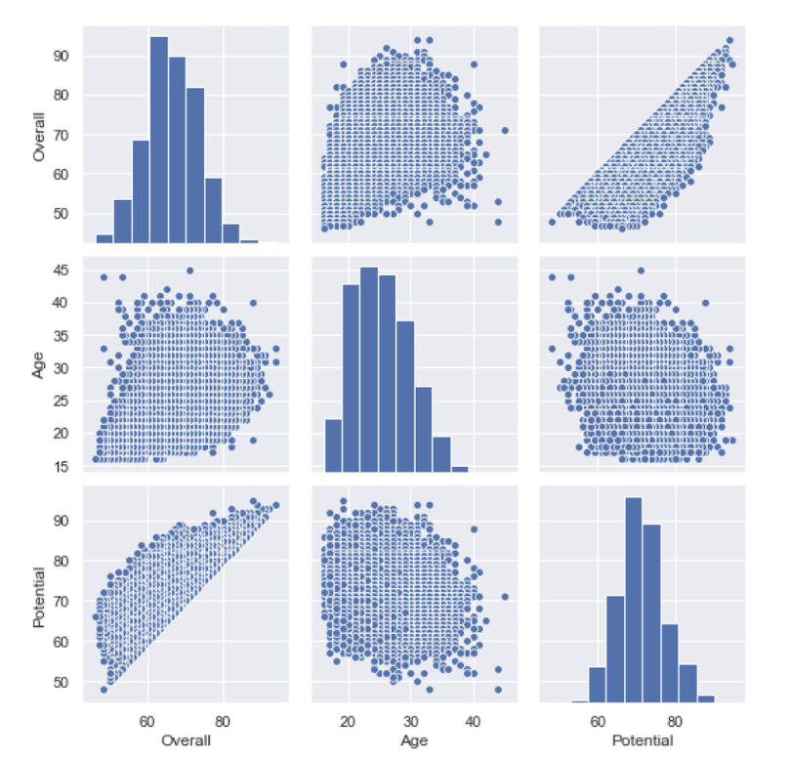
Seaborn Library for Statistical Data Visualization
Seaborn is built on top of Matplotlib and provides a high-level interface for creating attractive and informative visualizations.
With Seaborn, statistical plots like box plots, violin plots, and heatmaps can be generated to explore relationships within the Netflix dataset.
The library offers customization options to enhance the presentation of data insights.

Slide 9
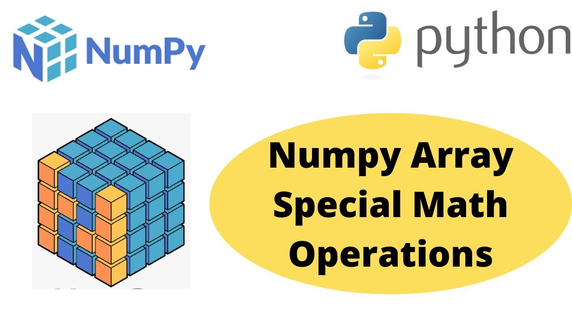
NumPy Library for Numerical Computing
NumPy is essential for performing numerical operations on the Netflix dataset.
Array manipulation, mathematical functions, and linear algebra operations can be efficiently executed using NumPy.
The library's array objects enable faster computation and analysis of large datasets.

Slide 10
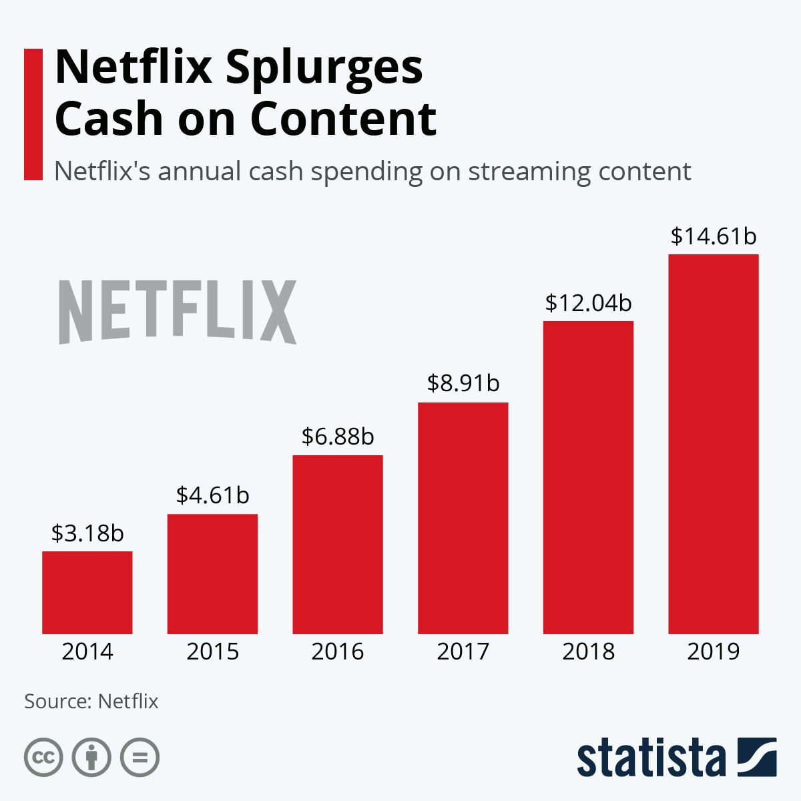
RESULT
Netflix program data research provided insightful information on viewer engagement and preferred content. Results show that most viewers interact with content for about 45 minutes each session, and that they have a strong inclination to binge-watch in the evening.
The most popular genres were found to be drama, comedy, and thriller, with ratings for new releases being higher. These insights offer actionable guidance for content creators and platform managers to tailor content strategies and enhance viewer satisfaction on the Netflix platform.

Slide 11
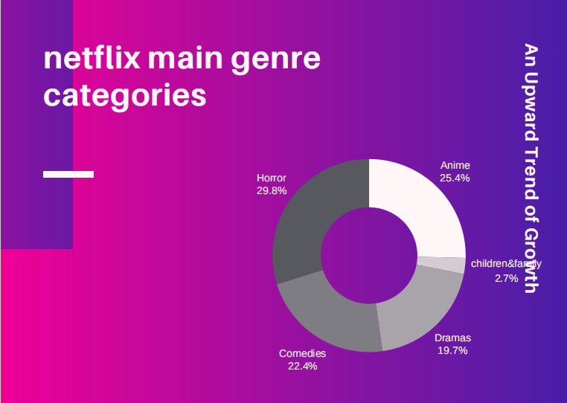
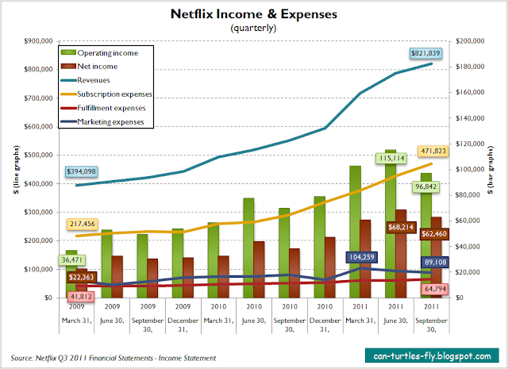
GRAPHS

Slide 12
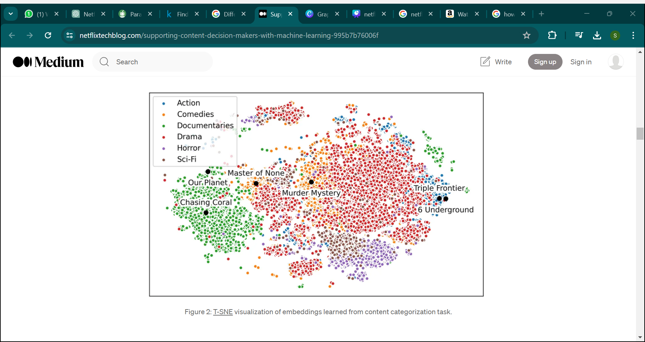

Slide 13
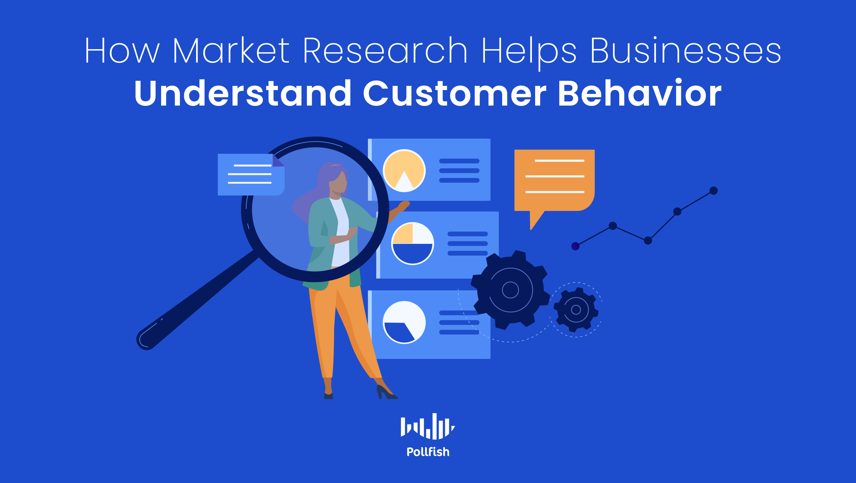
Conclusion
Data analysis is a powerful tool for understanding viewer behavior, optimizing content performance, and driving business growth in the competitive streaming landscape.
Netflix's data-driven approach to content creation, curation, and recommendation algorithms sets it apart in the industry.
By leveraging data analysis to uncover insights and trends, Netflix can continue to deliver engaging shows and personalized experiences to its global audience.
Notes:
Image source: https://resources.pollfish.com/survey-guides/understanding-customer-behavior-with-market-research/

